Slide 1

BIRD species identification
Nitasha

Slide 2

content
3 | Introduction
4 | Data Movement
5 | model
6 | website
10 | summary
13 | Thank you

Slide 3
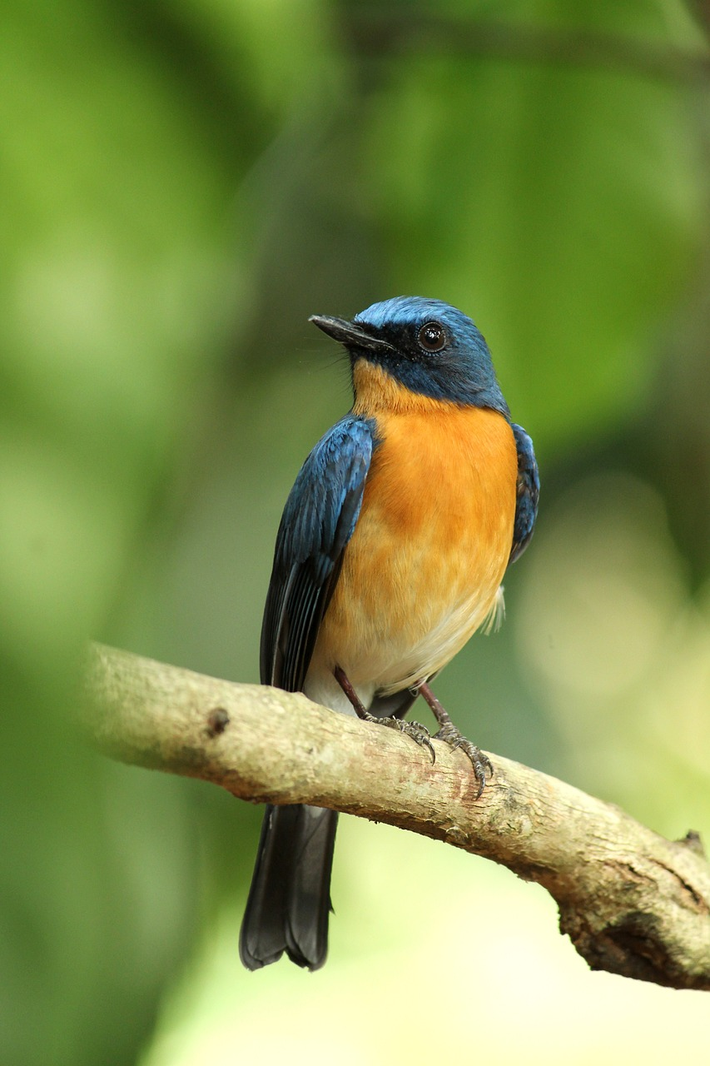
INTRODUCTION
This project dives machine learning methodologies in the realm of bird image classification, with a particular emphasis on their implications for educational initiatives. The primary objective is to develop robust classification models capable of accurately identifying avian species from visual data. It can classify up to 525 species.

Slide 4
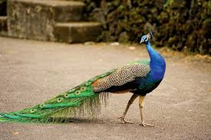
Input data
Output
Classes
Peacock

Slide 5
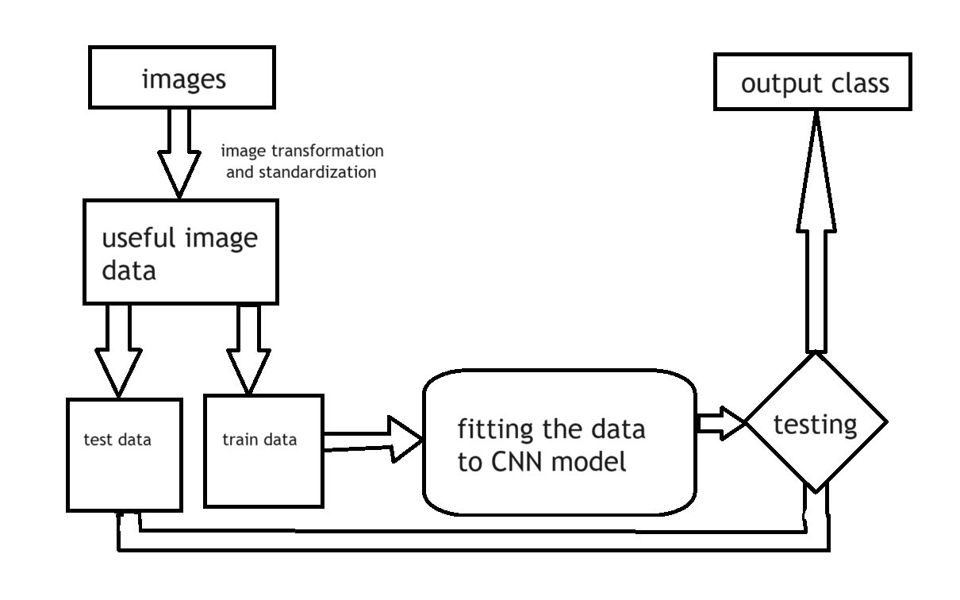
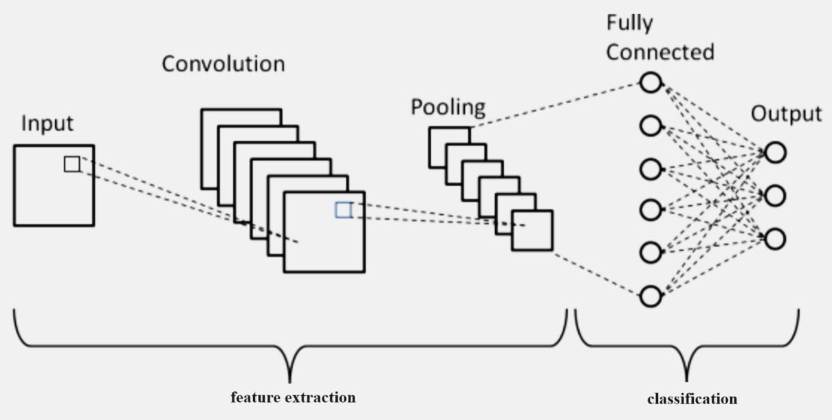
Model
CNN
Convolutional Neural Networks (CNNs) are a class of deep learning models specifically designed for processing grid-like data, such as images. They consist of multiple layers, including convolutional, pooling, and fully connected layers, each performing specific operations to extract and learn hierarchical features from input images.

Slide 6
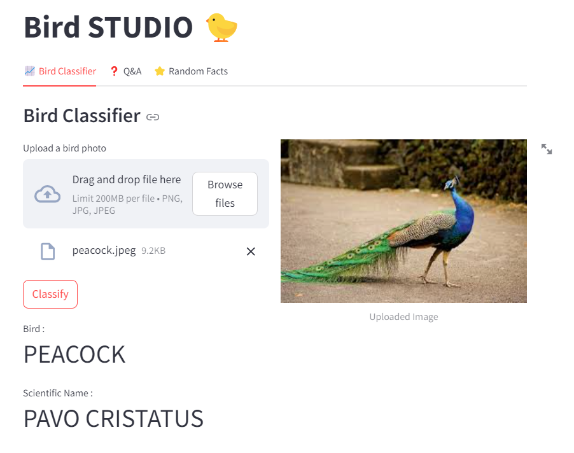
website
features
Multipurpose bird information platform.
You can upload any bird image from your device using browse files.
The bird will be classified into either of the 525 categories by pre trained model dynamically.
You can ask questions and get answered directly.
Get random facts about birds
The website has a modern and easy to use approach.
The website was made using STREAMLIT.

Slide 7
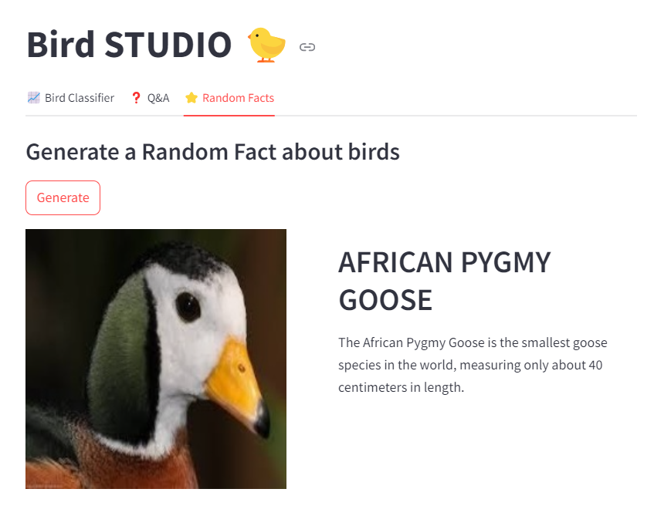
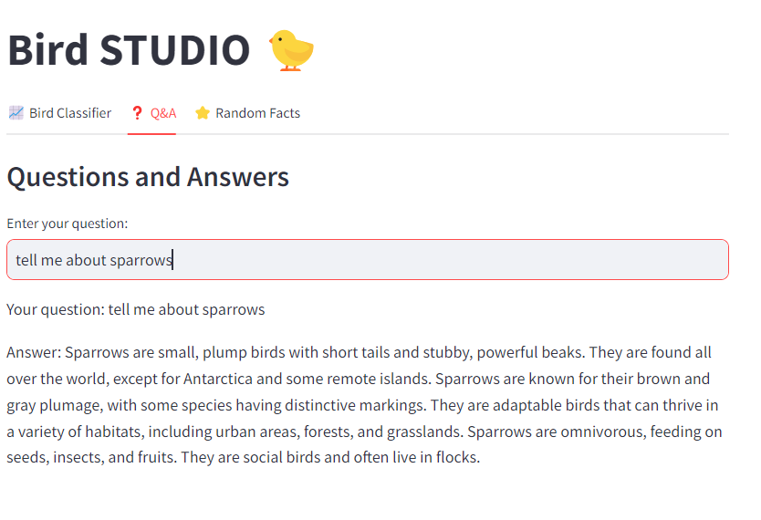
website

Slide 8
SUMMARY
I created an interactive website where users can upload pictures of birds to learn about them. An identifier processes the uploaded image to determine the bird species, and users can interact with a chat-bot to receive additional information. The platform also features an option to learn about random birds, making it a fun and educational experience for bird enthusiasts.

Slide 9
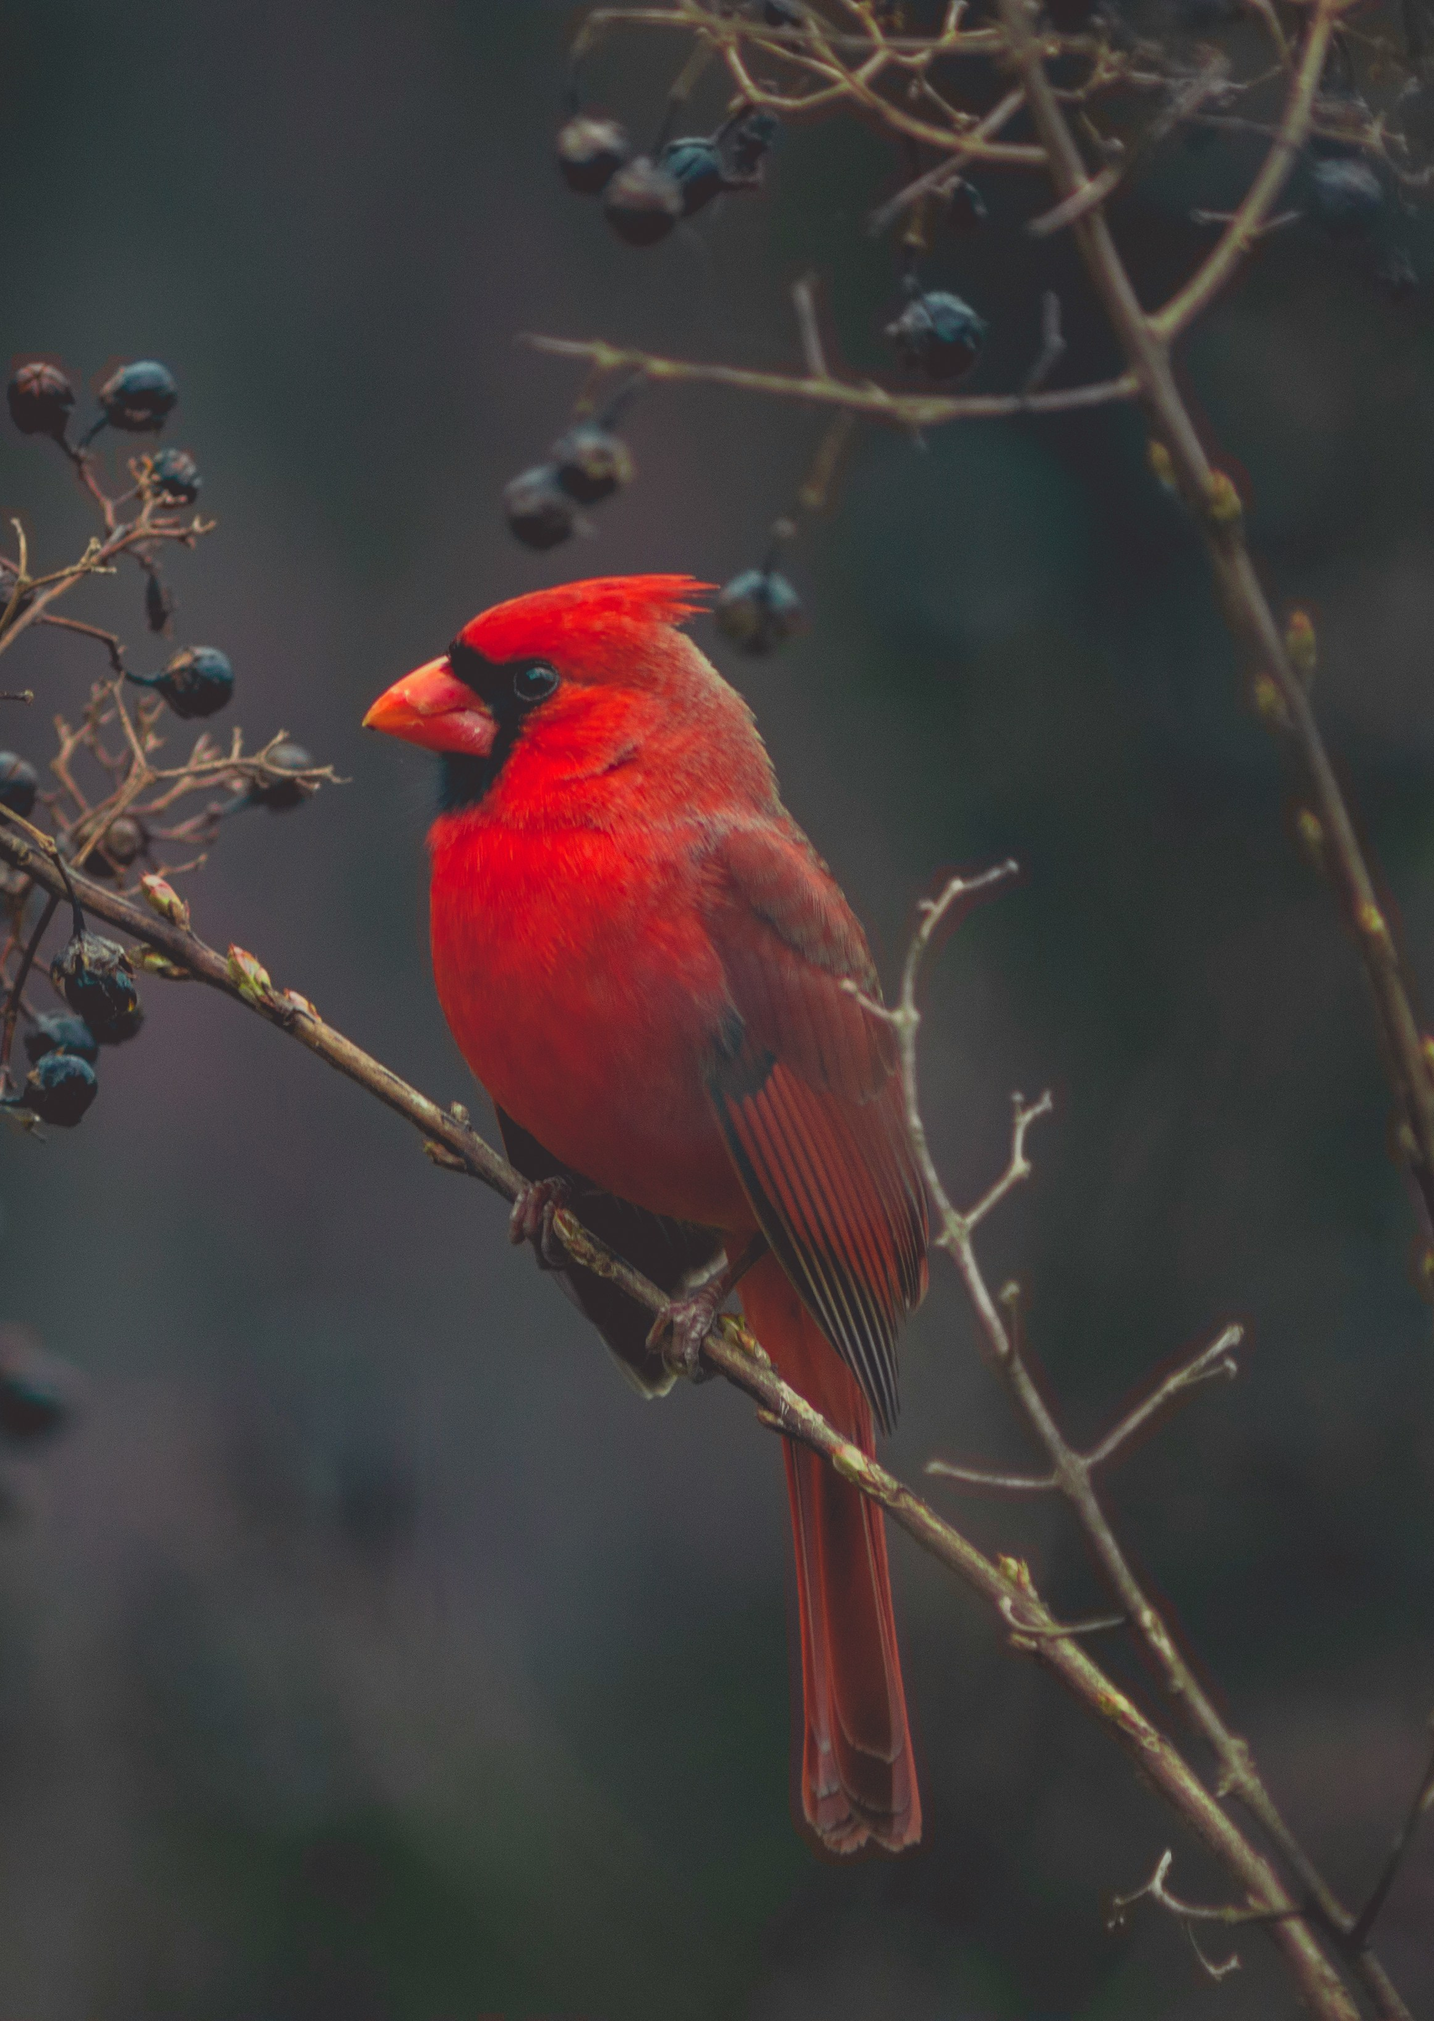
THANK YOU
Nitasha
https://birdclassifier2210991996.streamlit.app/
Github Link:

